Slide 1
Testing Tools

Slide 2
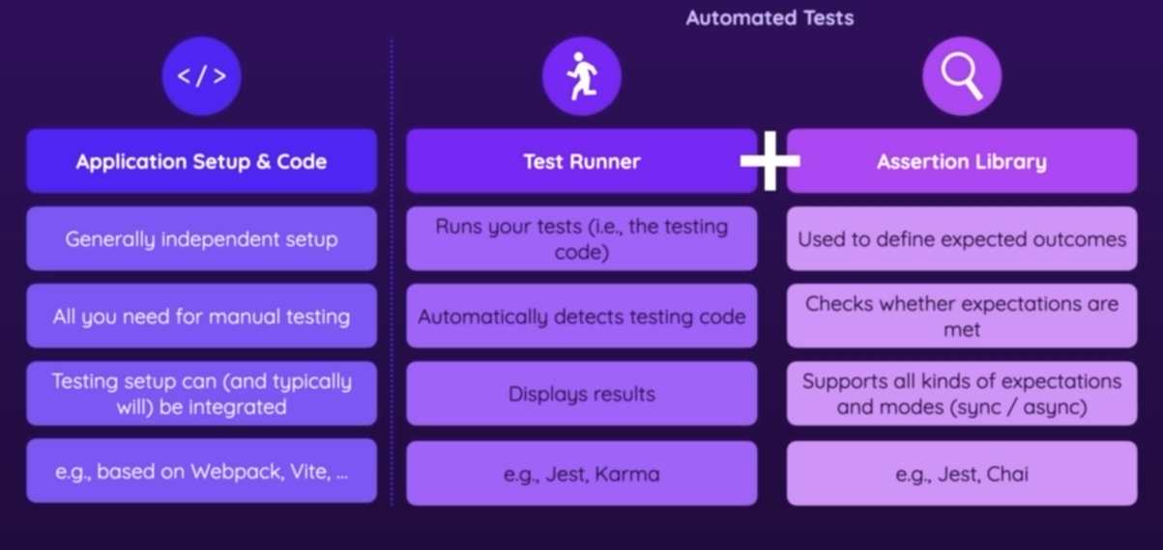

Slide 3
Jest vs Vitest
Jest is good but does not support ESM modules , Vitest supports both commonJs and ESM modules

Slide 4
Installation
npm install --save-dev jest
npm install -D vitest

